Slide 1
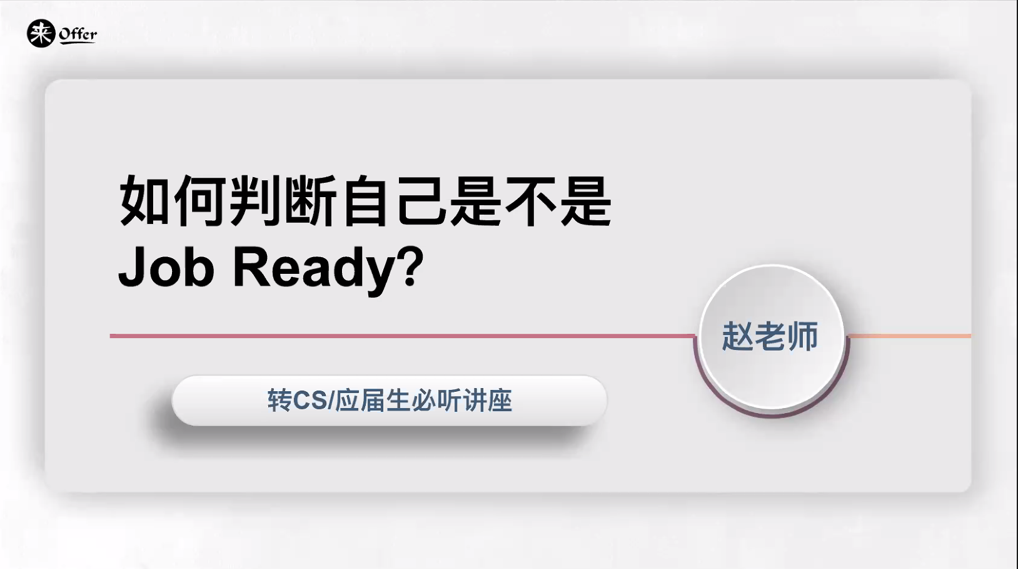

Slide 2
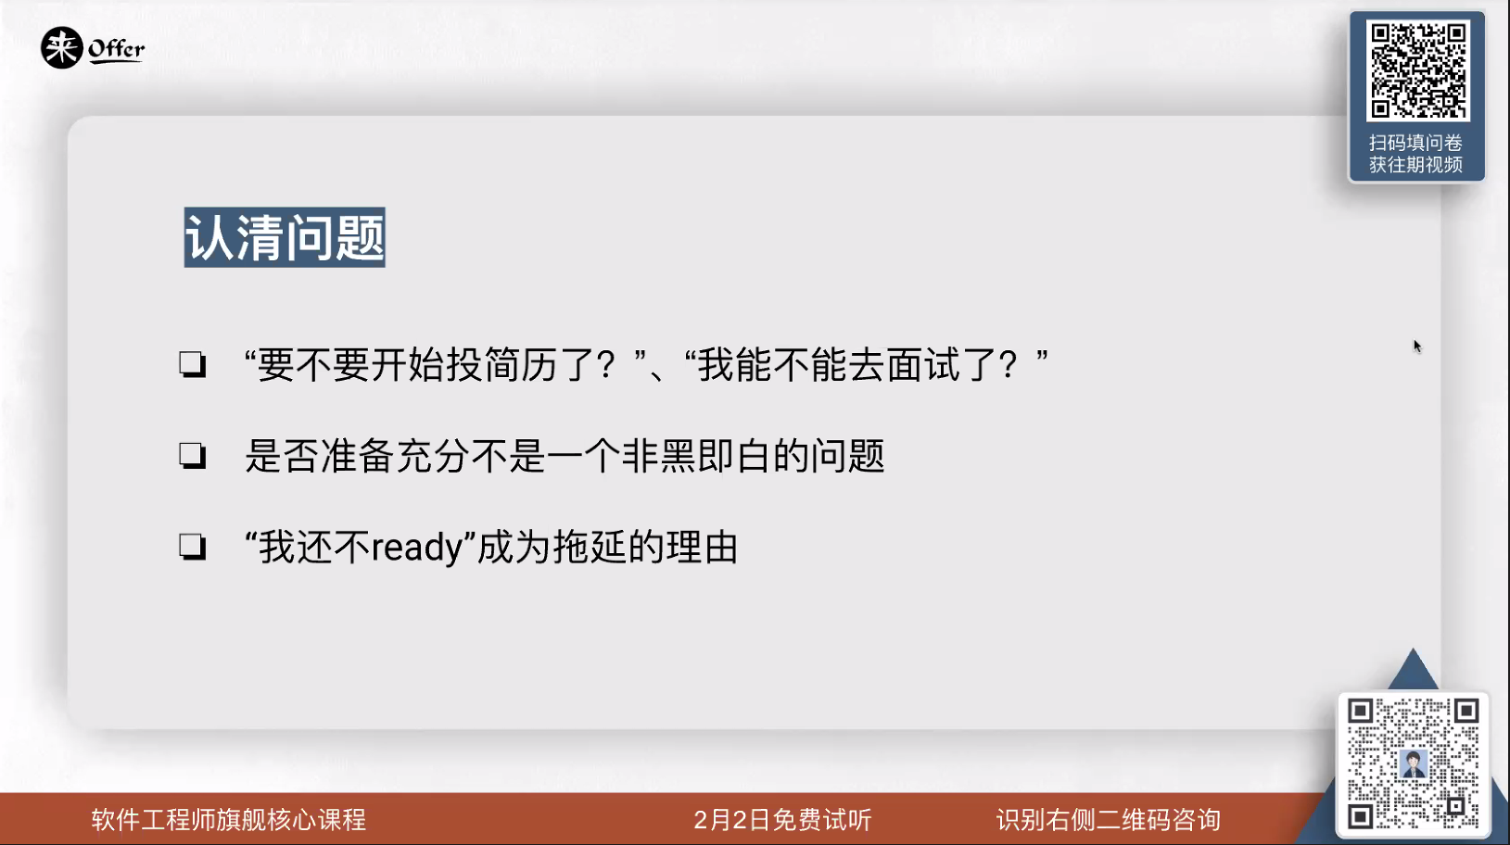

Slide 3
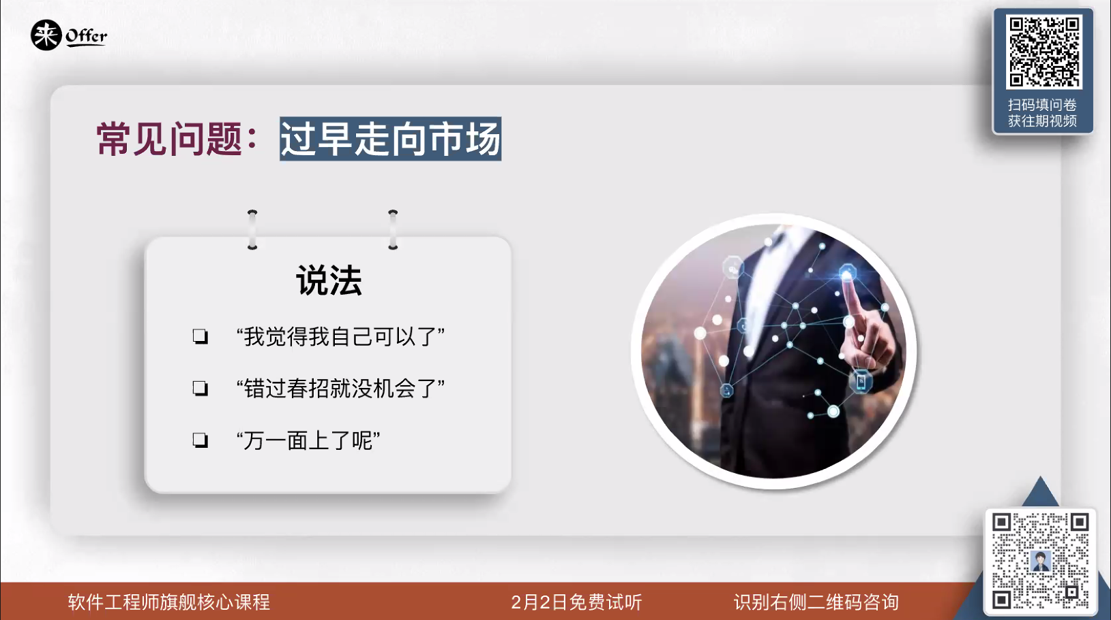

Slide 4
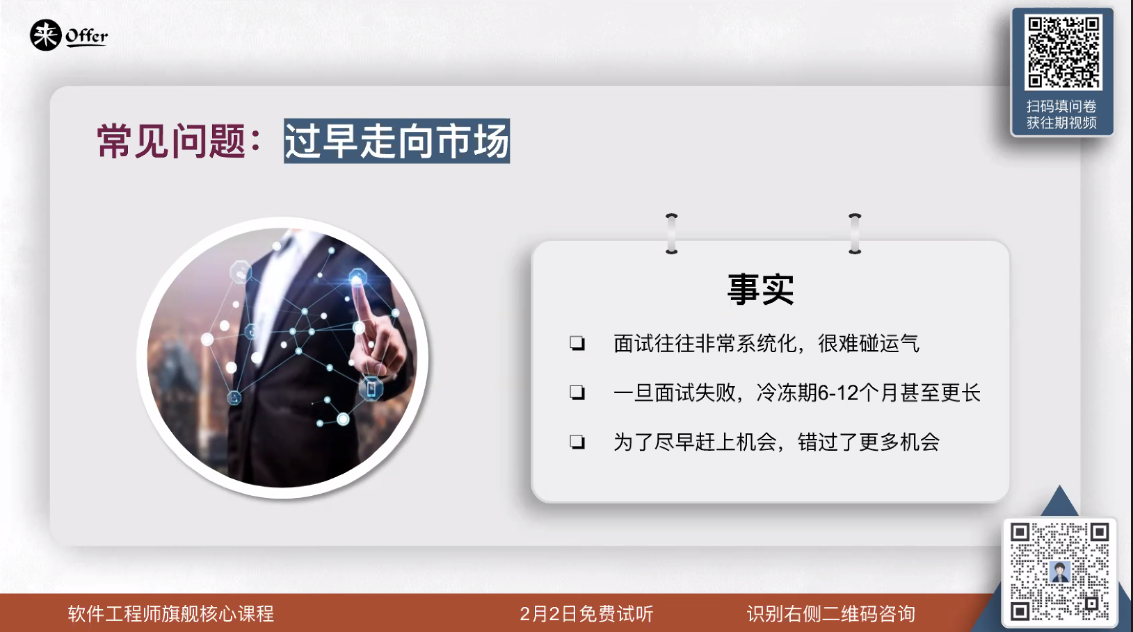

Slide 5
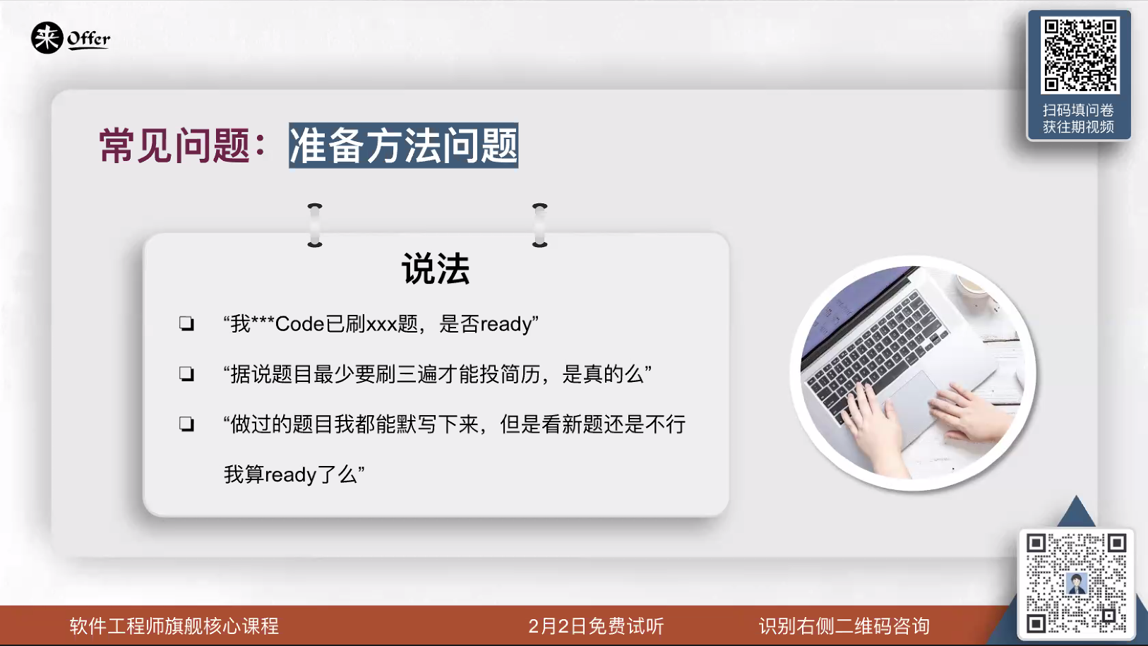

Slide 6
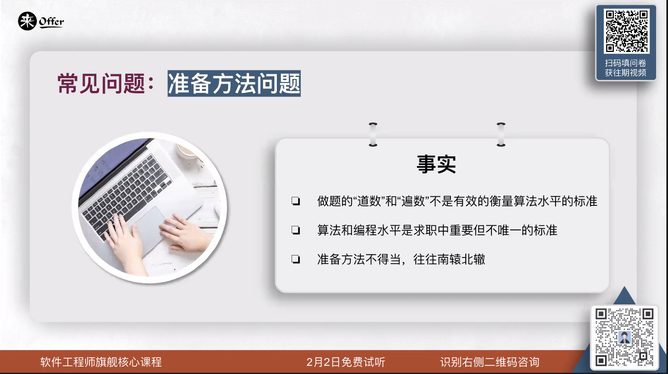

Slide 7
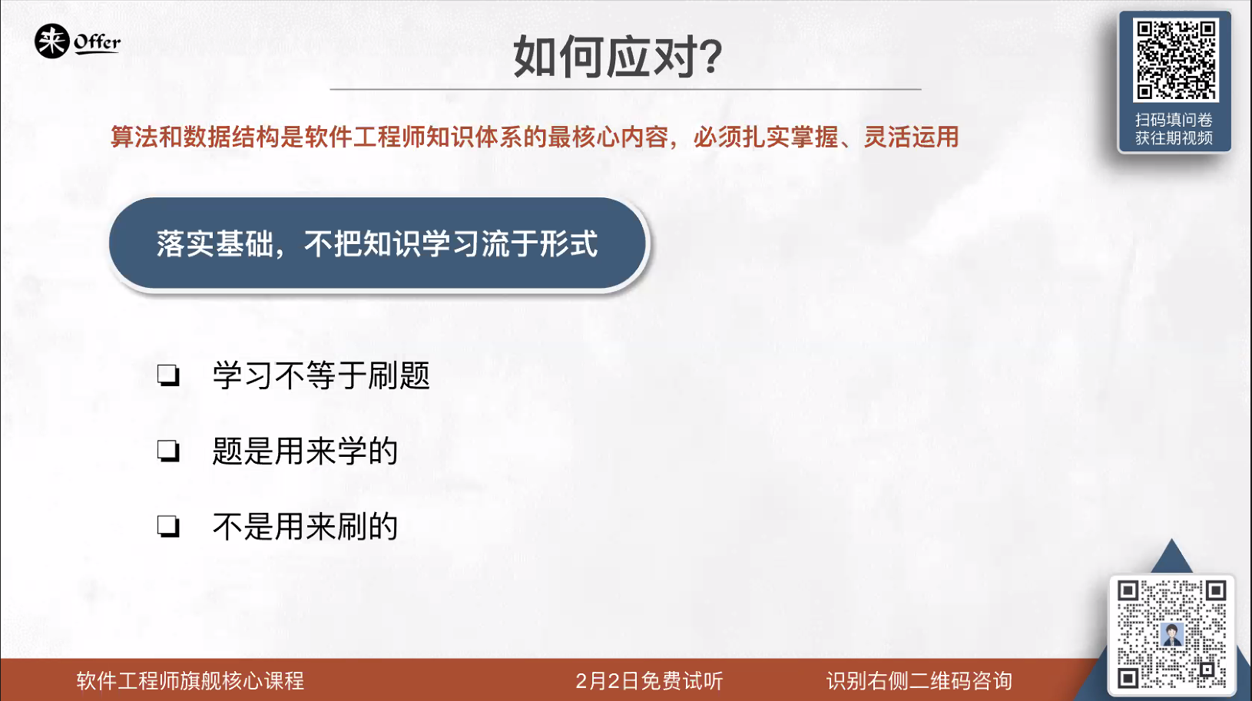

Slide 8
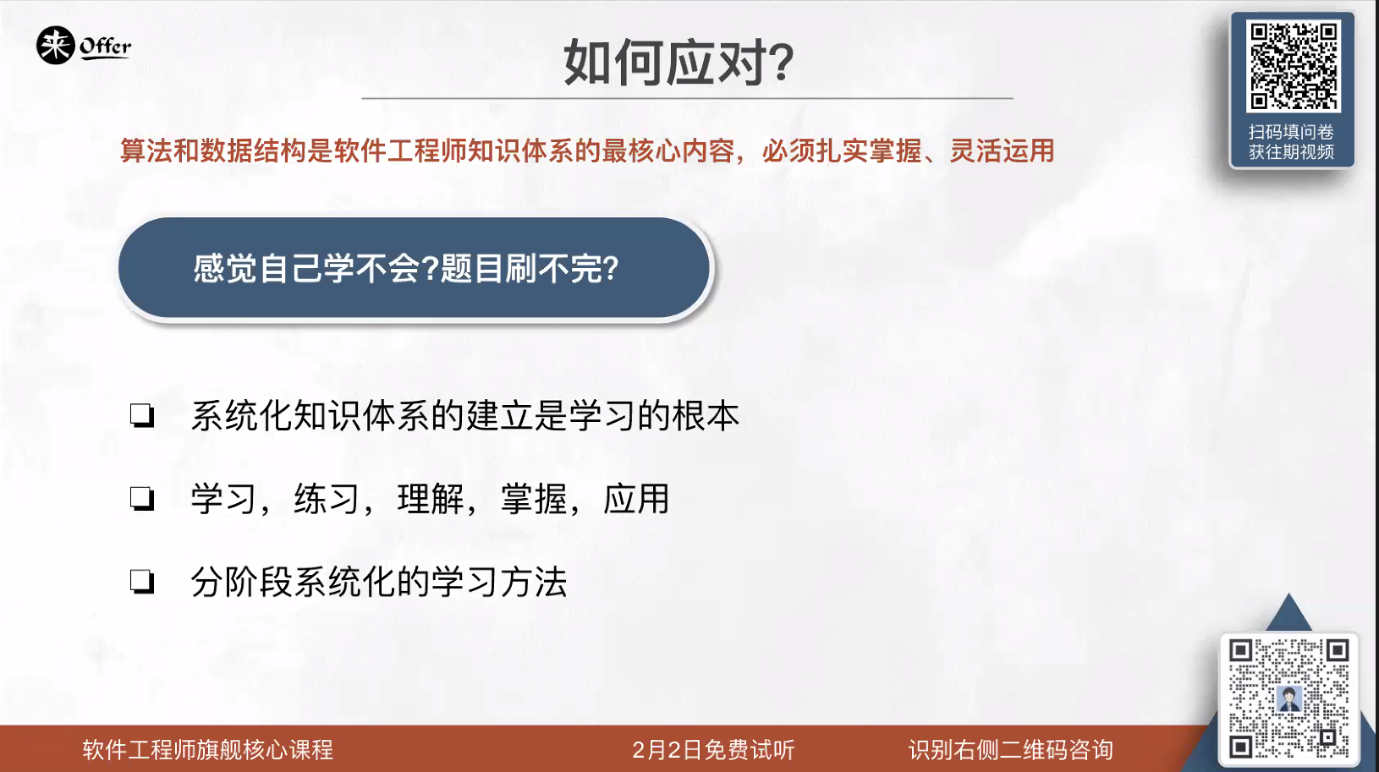

Slide 9


Slide 10
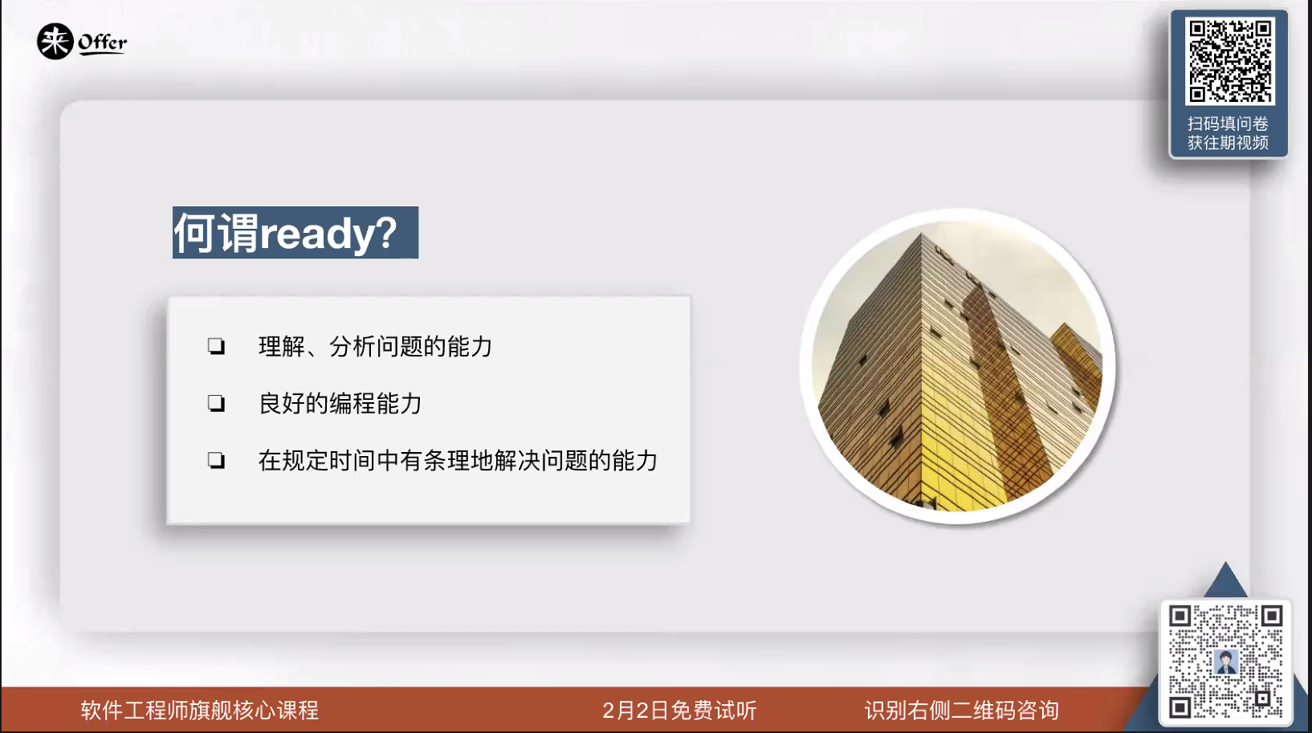

Slide 11
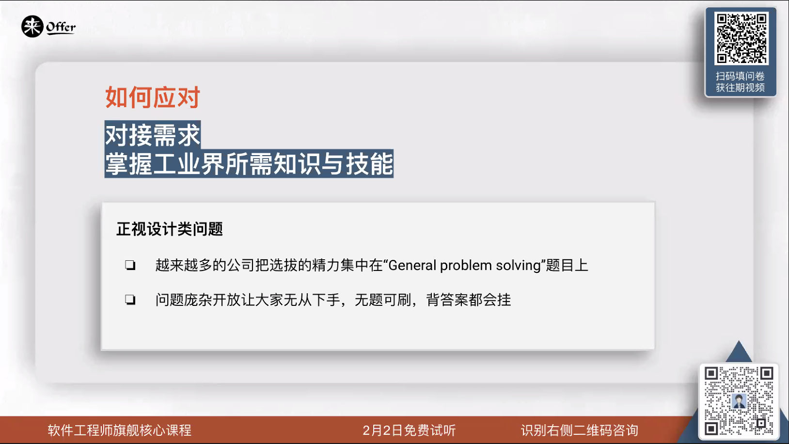

Slide 12
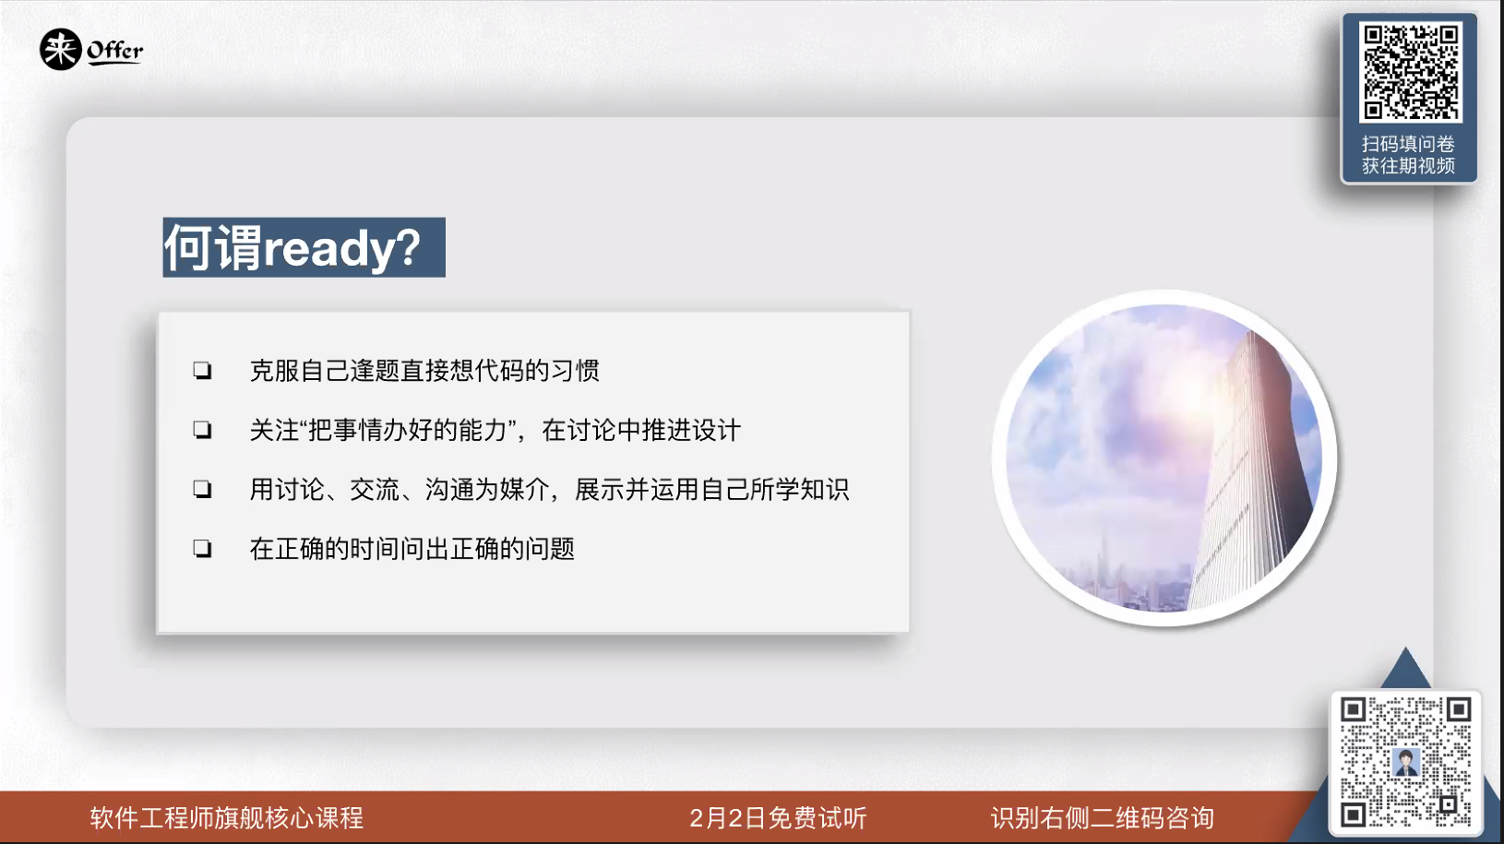

Slide 13
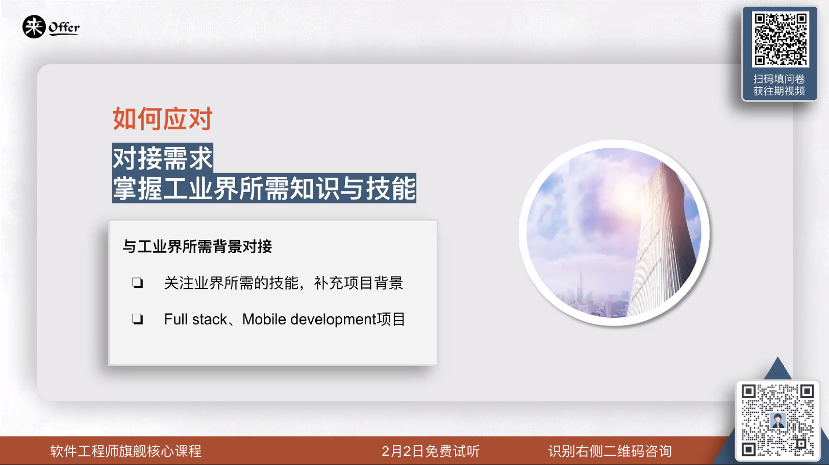

Slide 14
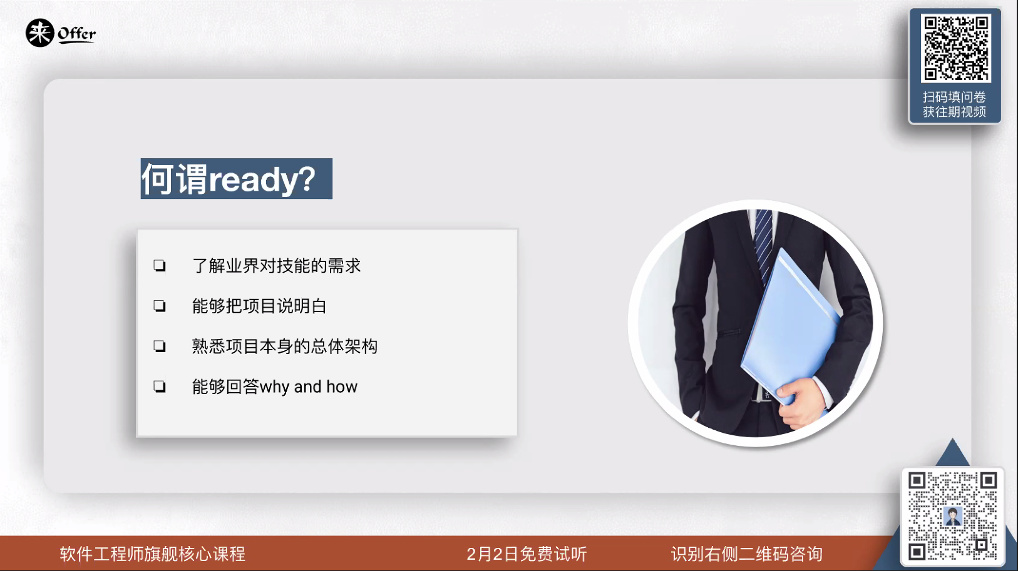

Slide 15
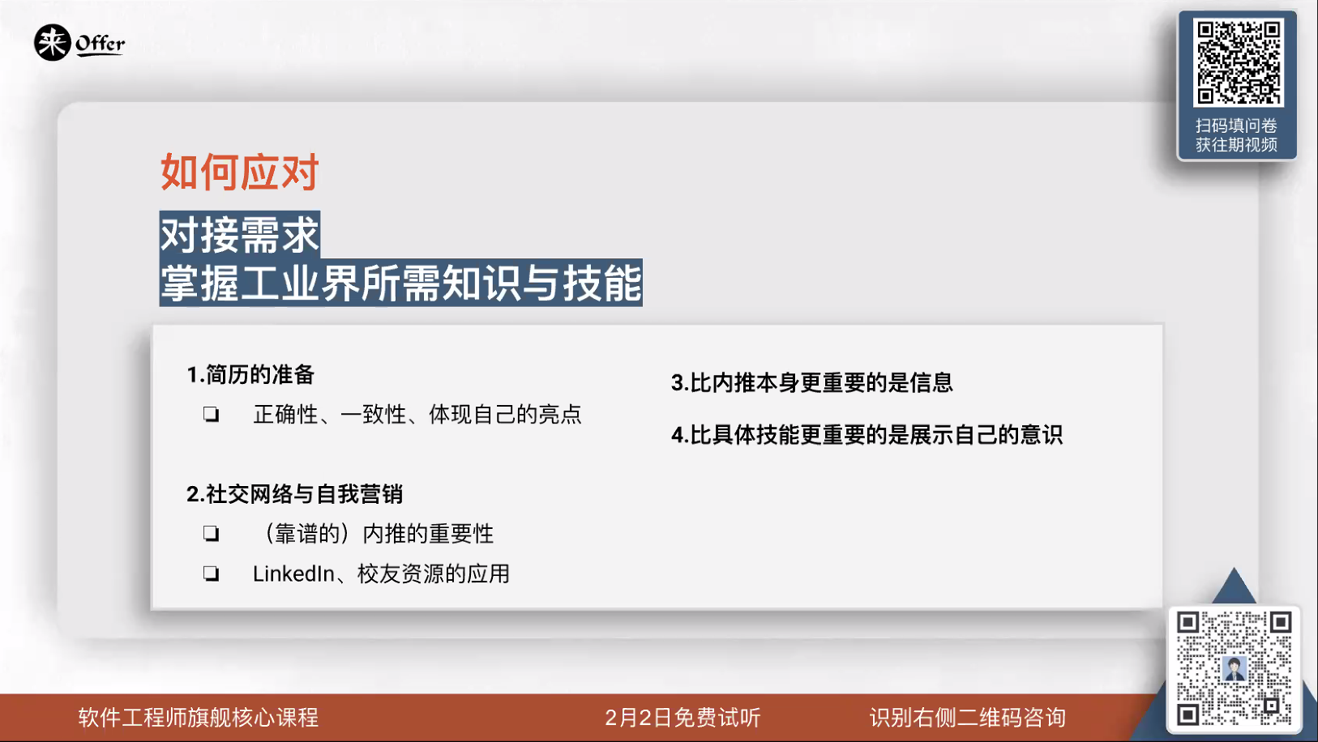

Slide 17
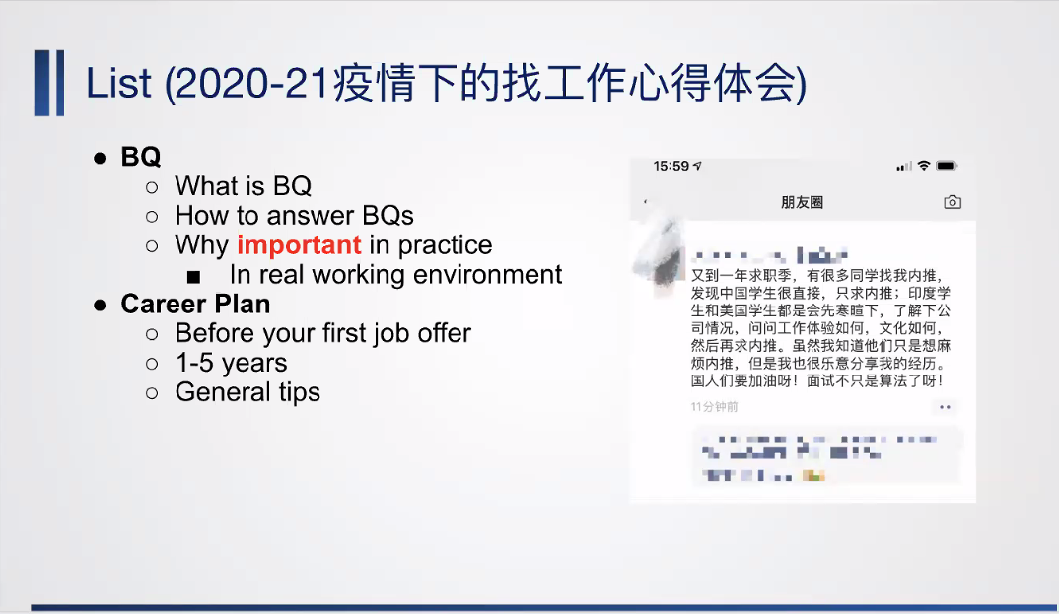

Slide 18
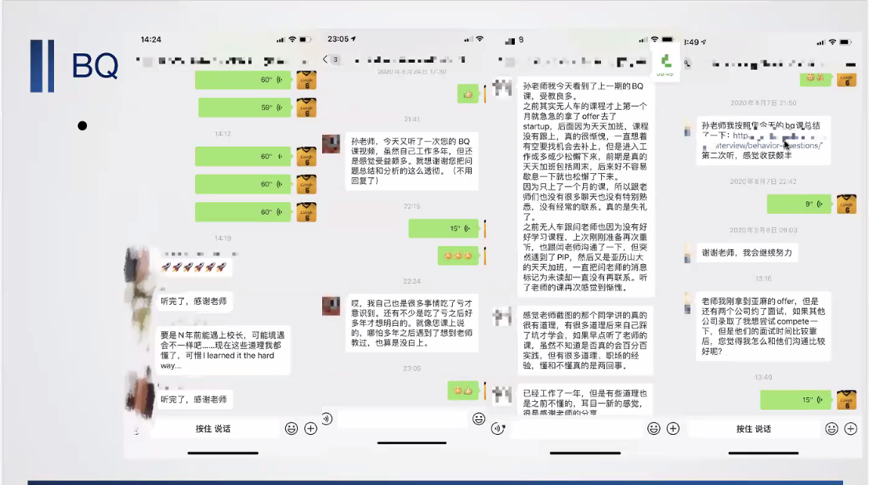

Slide 19
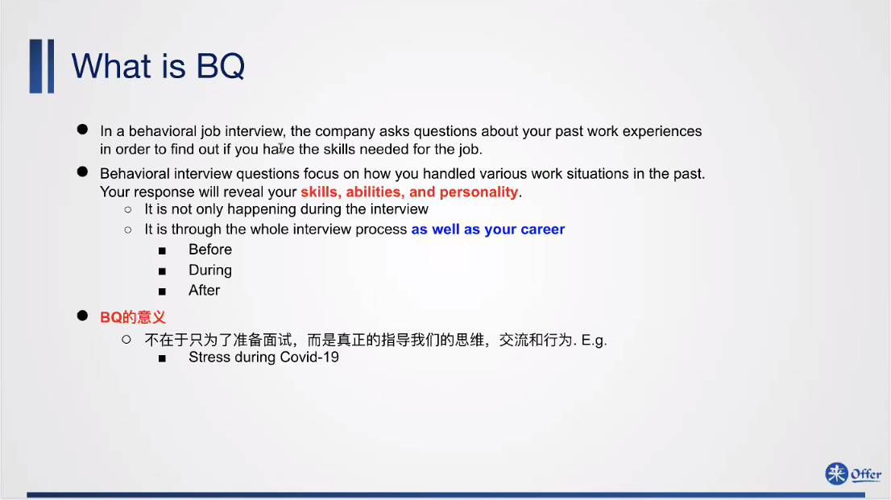

Slide 20
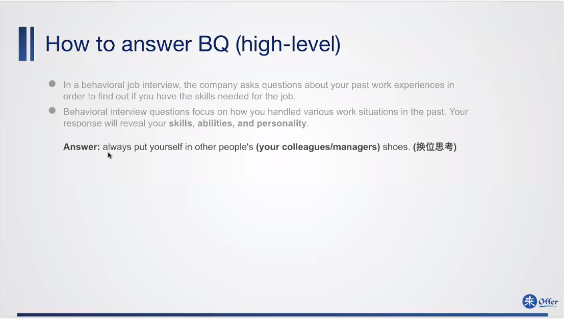

Slide 21
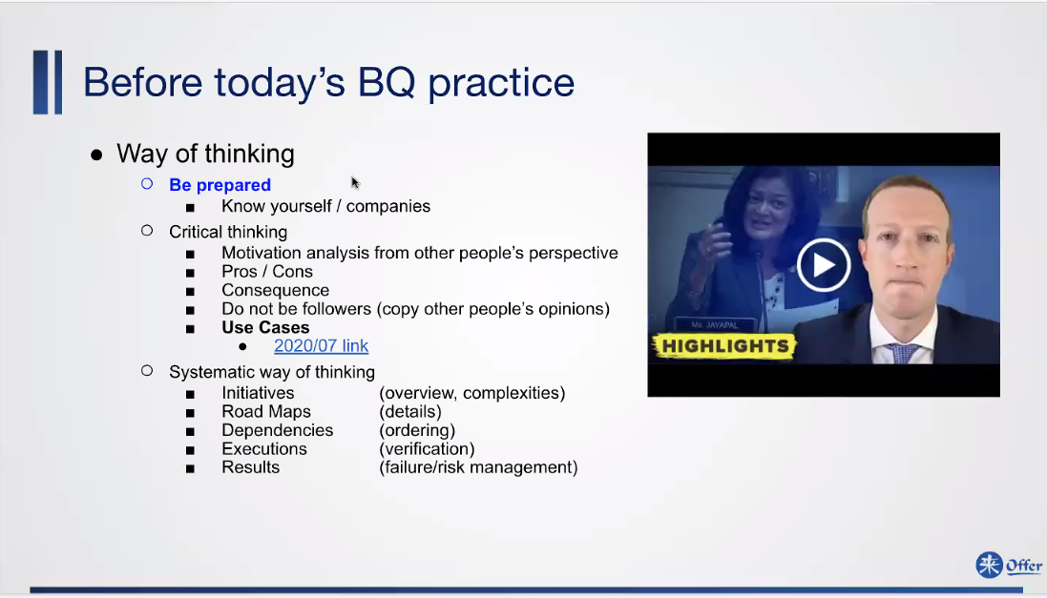

Slide 22
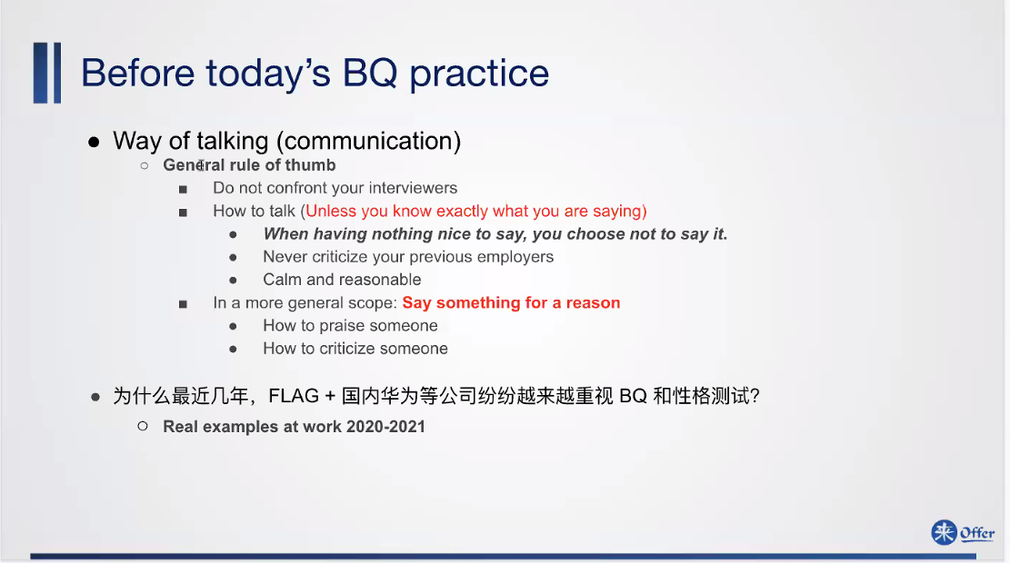

Slide 23
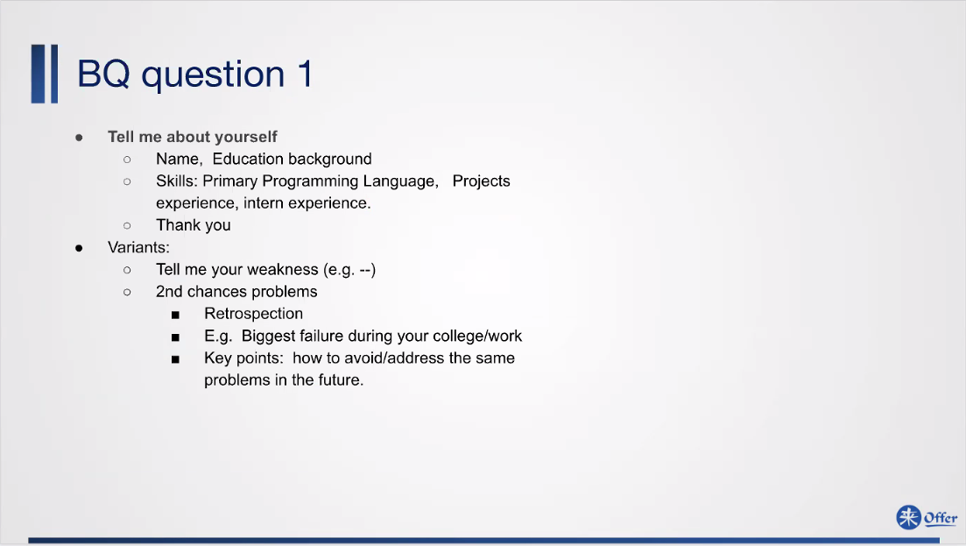
Notes:
Ability of retrospect
How will you address it?
Example: easy to be distracted when dealing with multiple threads.
In the future, learn the dependency and determine the priority.

Slide 24
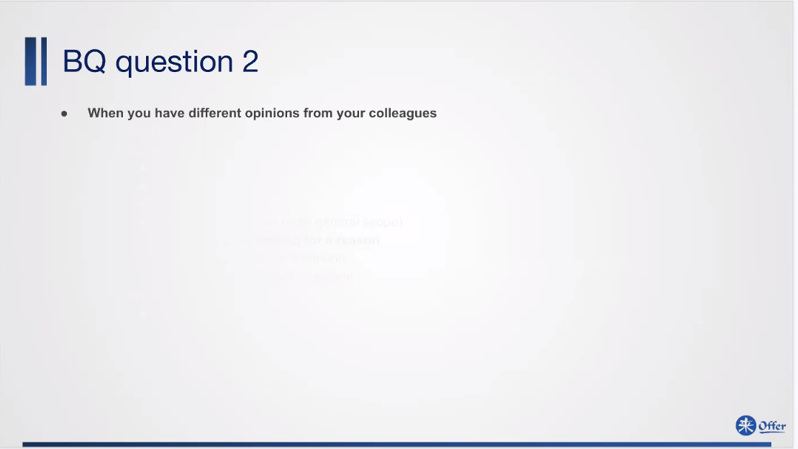
Notes:
X: You are wrong!!!
R: Can you try another way??? This …. May work. If you have any ideas, I am more than willing to discuss with you – Wei Zhang

Slide 25
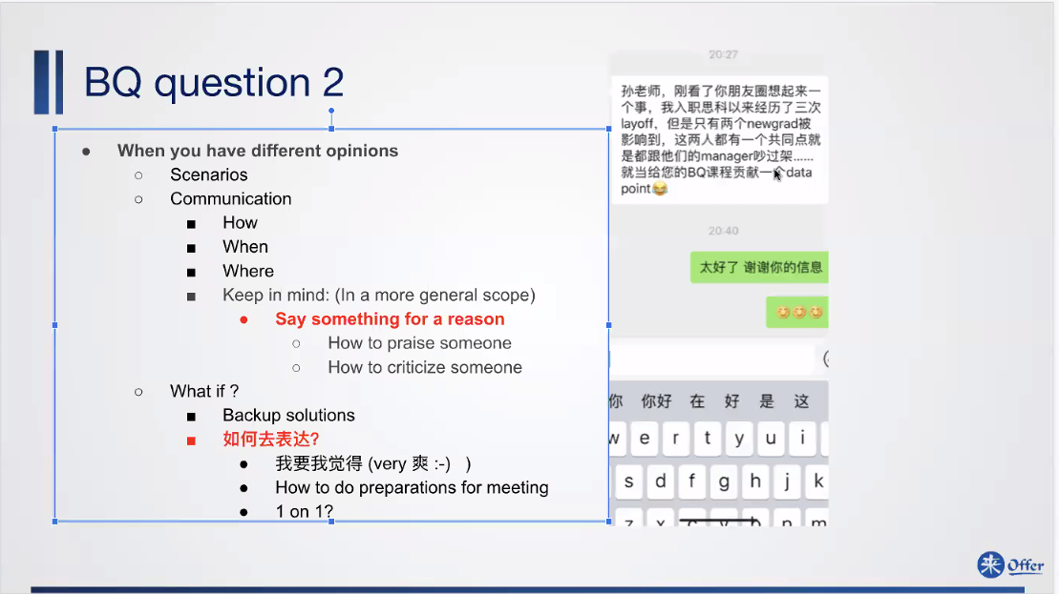
Notes:
Praise the person in public way – praise the person, not the affair
Criticize the person personally – criticize for only the accident, not the person.

Slide 26
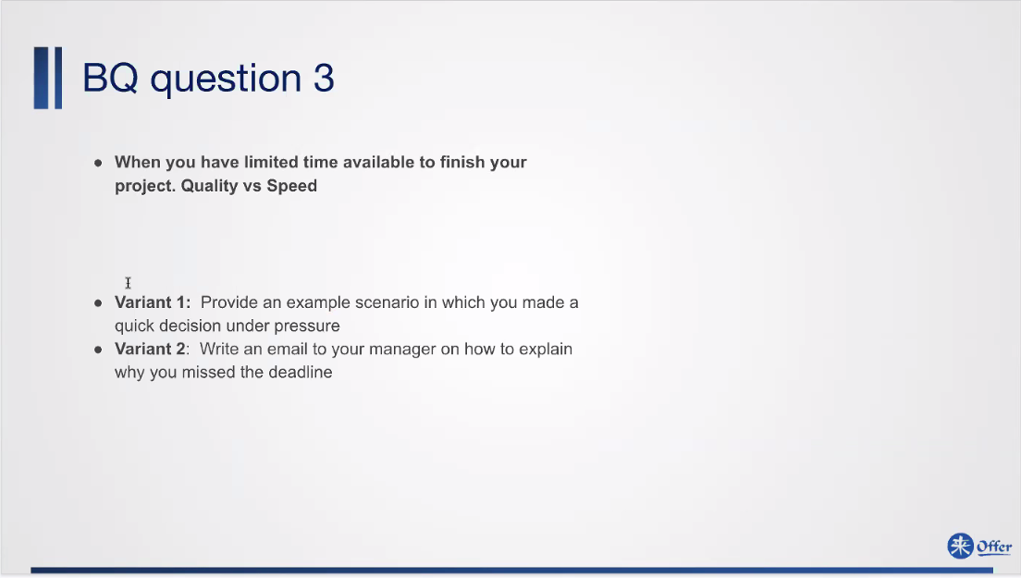
Notes:
Priority: A or B? – traps – it depends;

Slide 27
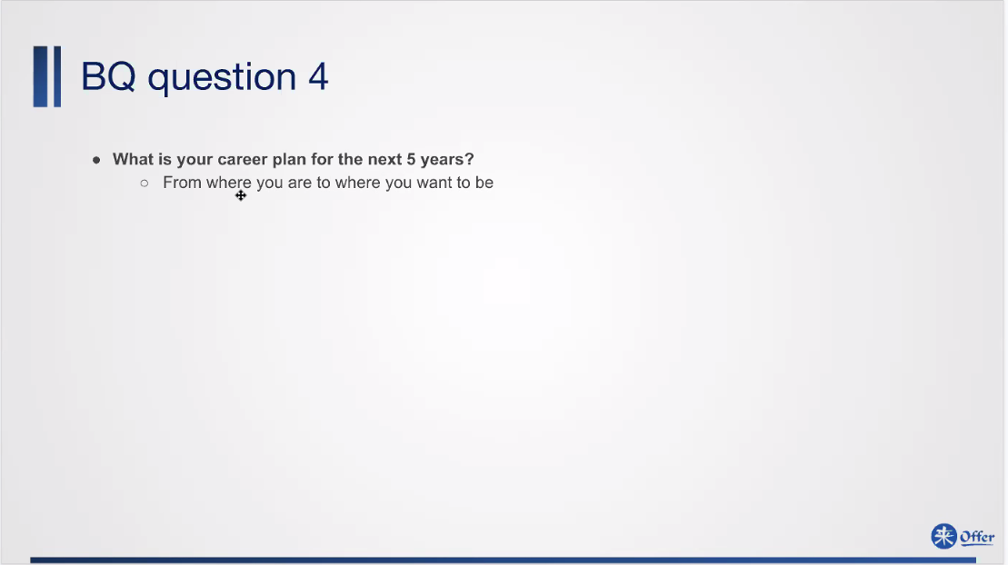
Notes:
Answer A and A+;
Target:
Have achieved: skills
Plans:
Three levels of plans:
In the next month
In the next one or two years
In the next 5 years

Slide 28
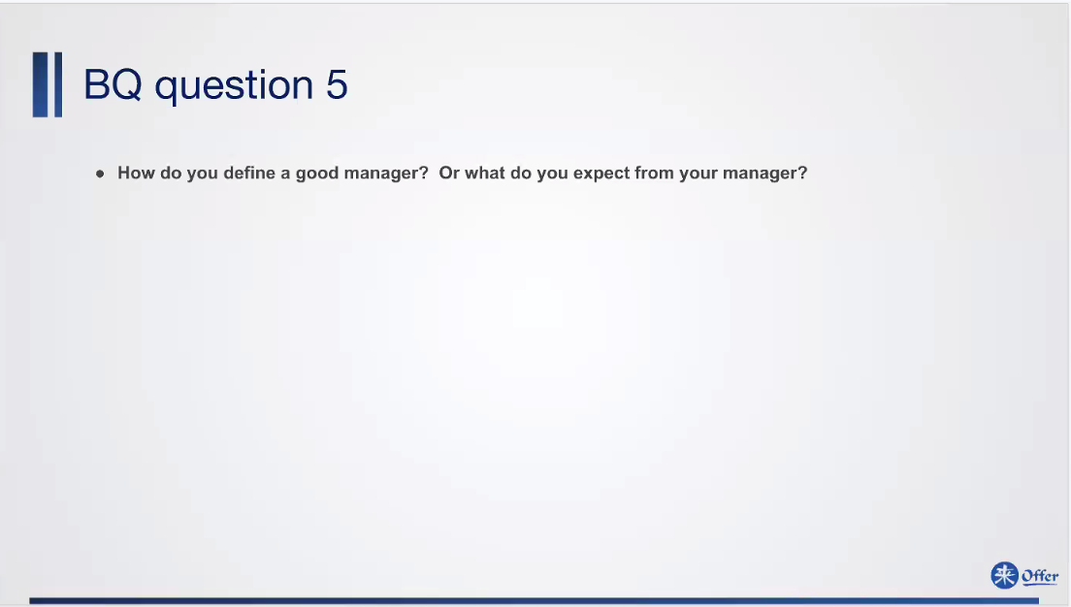
Notes:
Newly added questions!
Don’t criticize your previous employer
SUN’s answer:
Soul mentor – potential and shortcomings – guide you advance to next level and benefit the whole company/field and career;
Request fulfiller – too busy, always be helpful, ok – but do one, two, three
Fair manager 50% - no advance plan, help with condition, criticize and praise fairly
Mean Pusher 30%~40% - everything done very hashly
PIP loader – once little mistake, fire the employee.

Slide 29
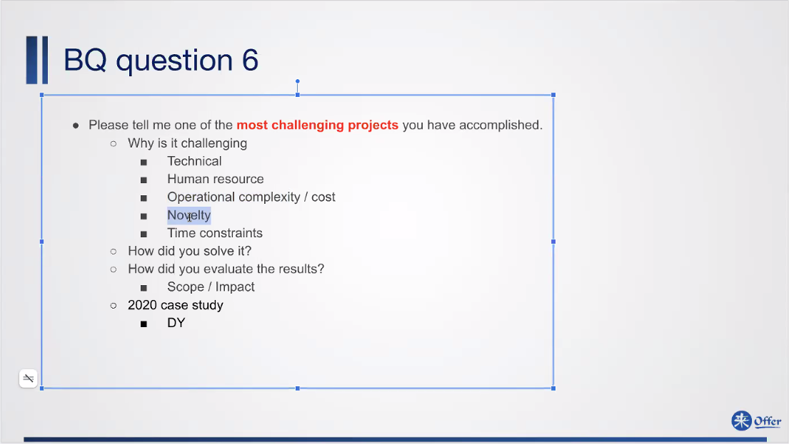
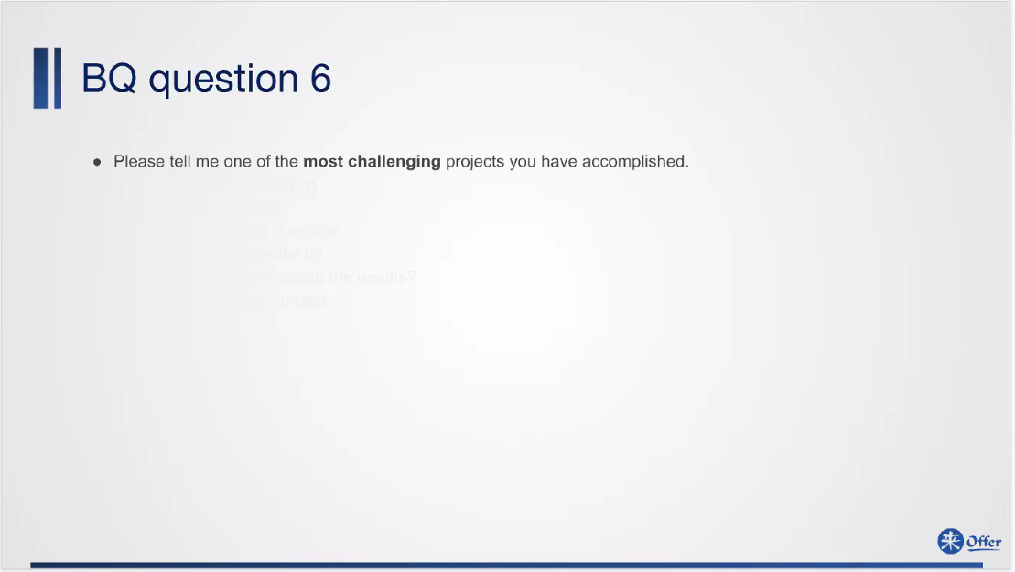
Notes:
Most wanted answers:
Hiring committee: from leadership, how to lead a team and conquer the project?
Challenging: enter the company, but leader leave;
Operational committee: ask for cooperation, do lots of optional complexity; not
Novelty:

Slide 30
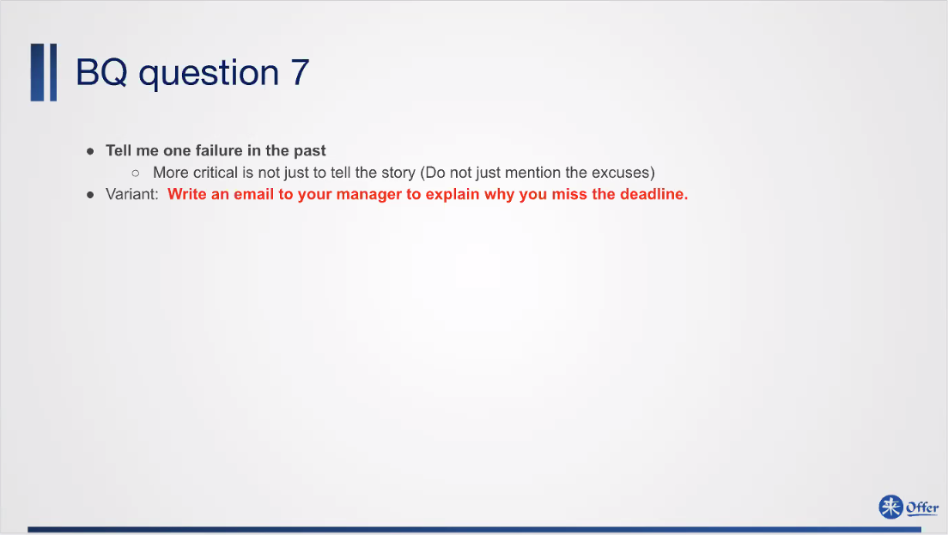

Slide 31
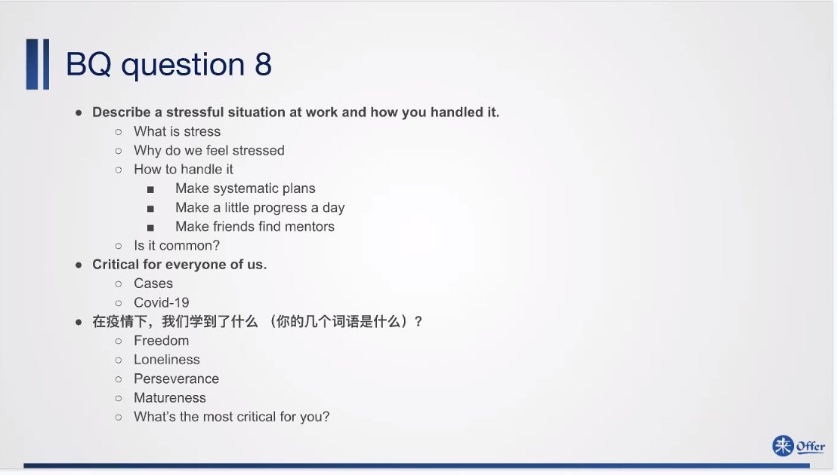

Slide 32
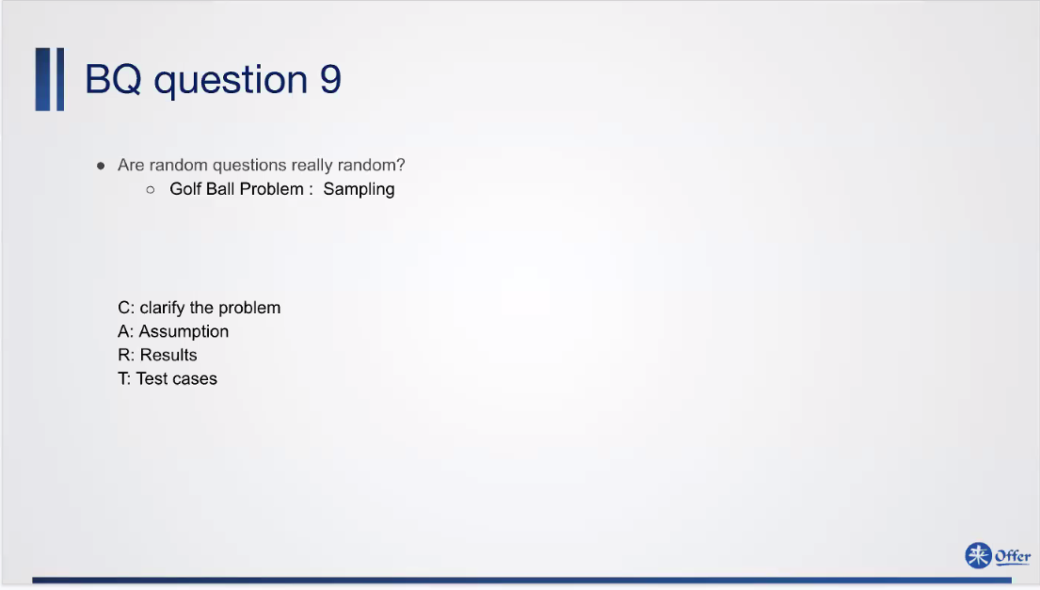

Slide 33
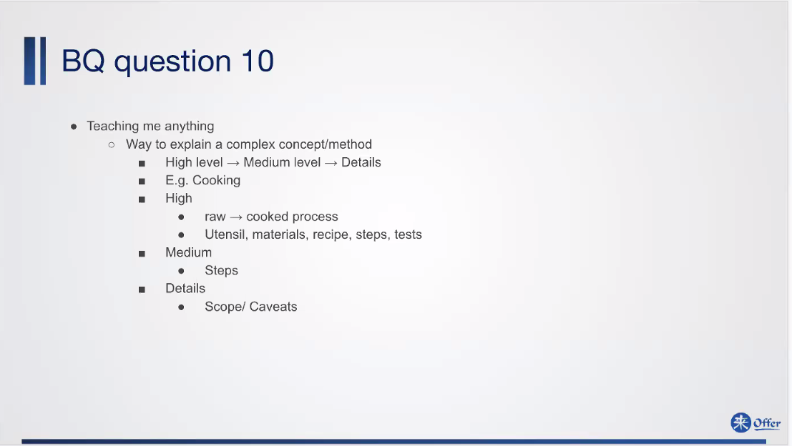
Notes:
Opposite: how do you learn anything?

Slide 34
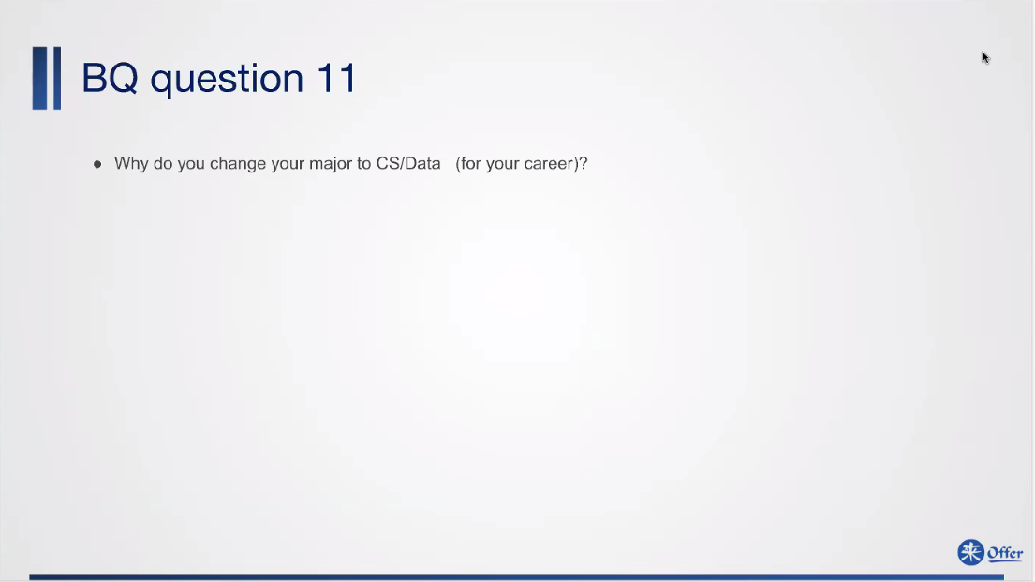
Notes:
Why haven’t you found a job?
Significant impact – millions of people

Slide 35
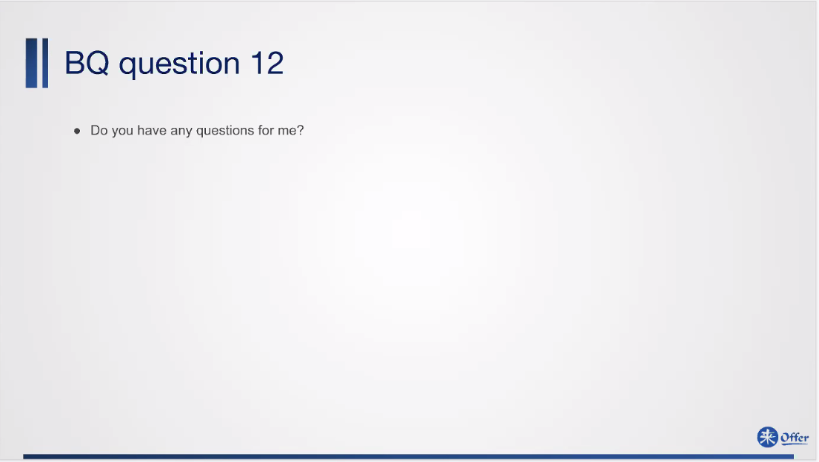
Notes:
Technical questions: - challenging project?
Curiosity, work hard,

Slide 36
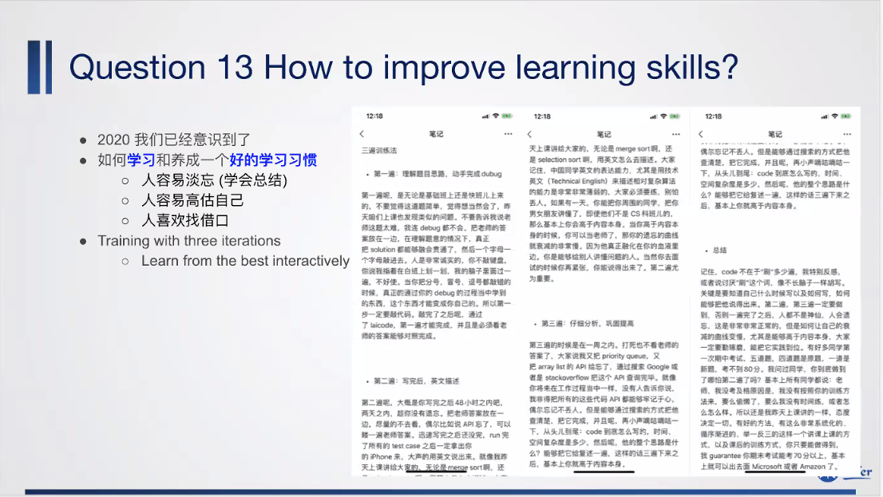

Slide 37
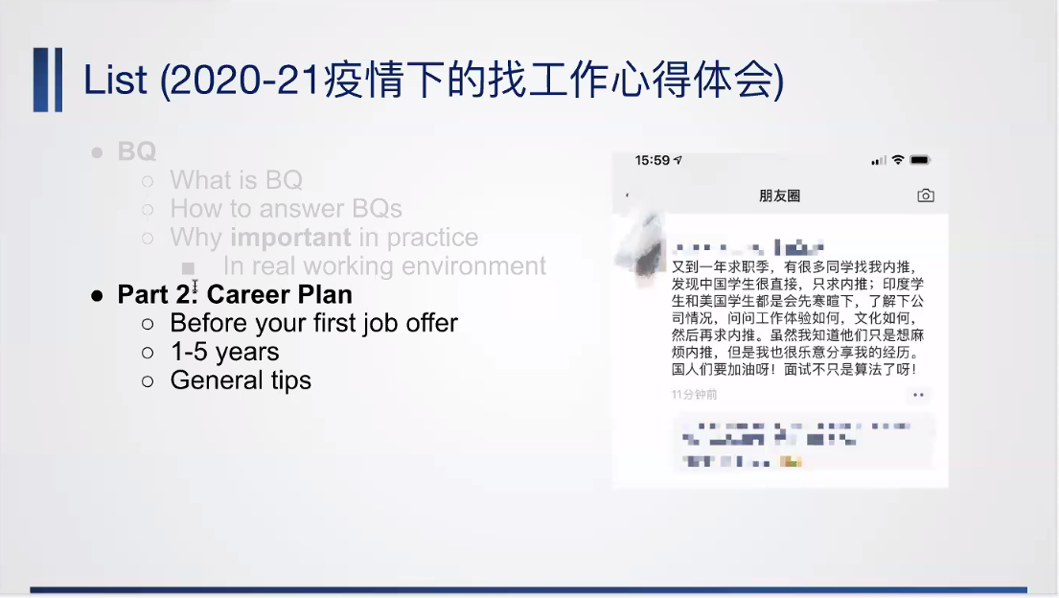
是是是是

Slide 38
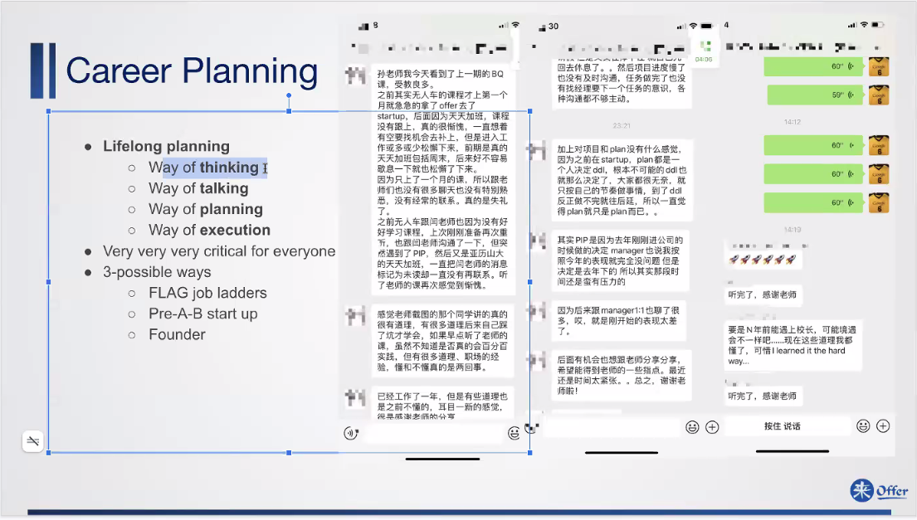

Slide 39
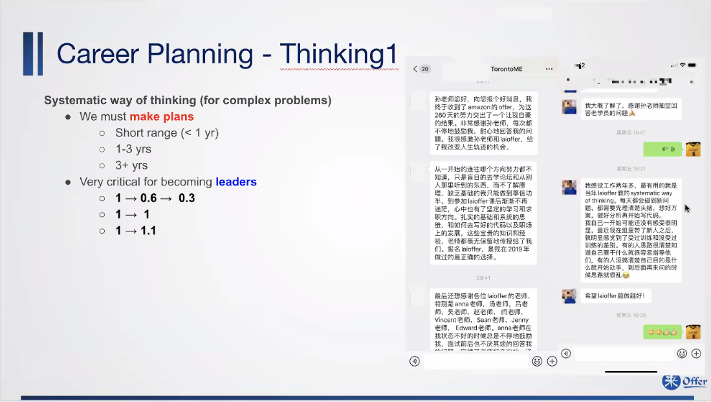

Slide 40
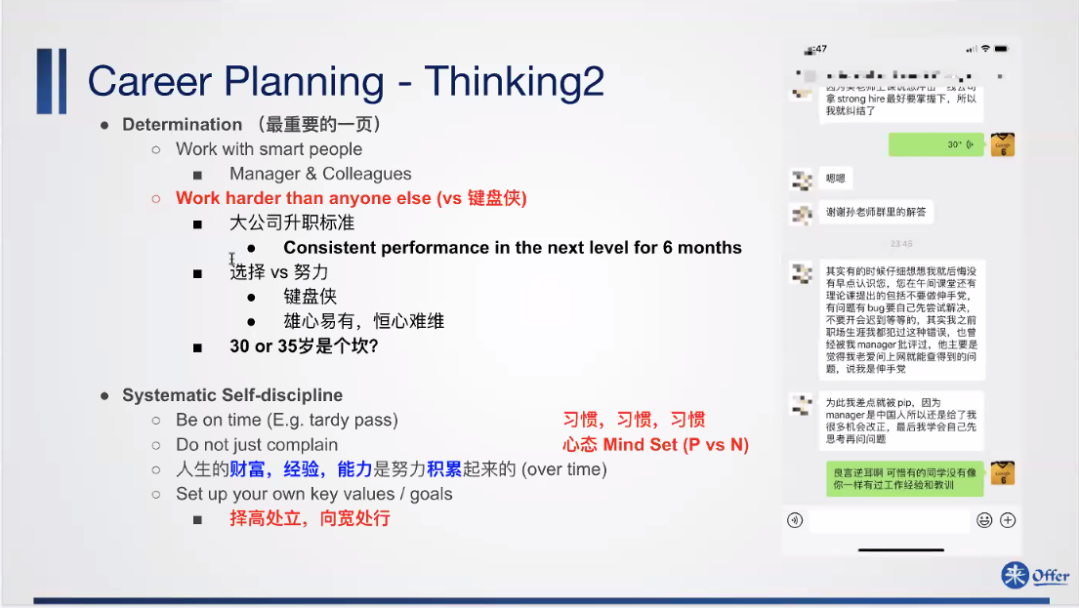

Slide 41
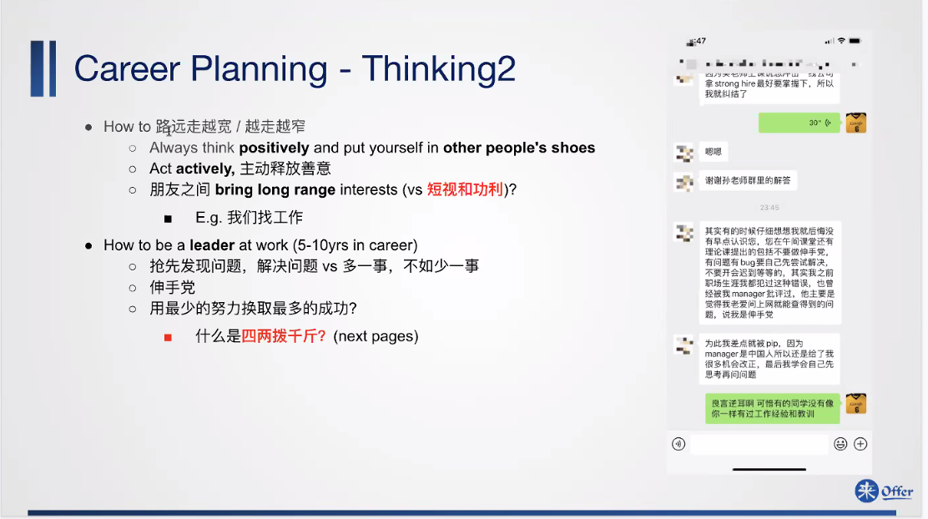

Slide 42
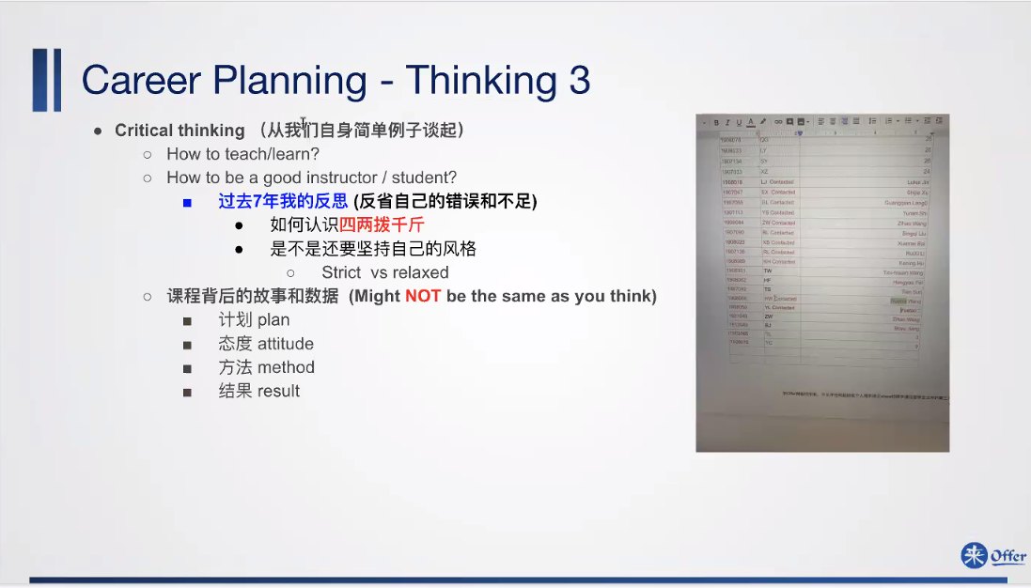

Slide 43
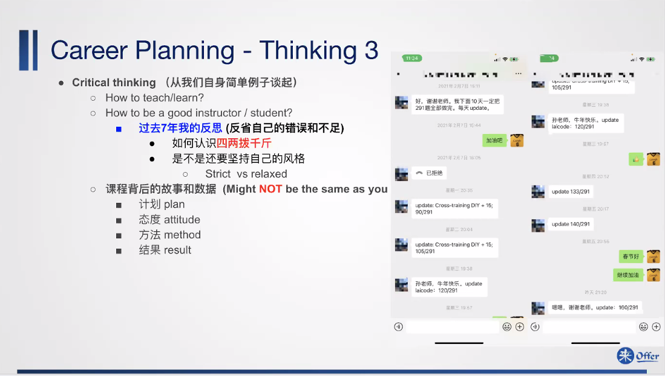

Slide 44
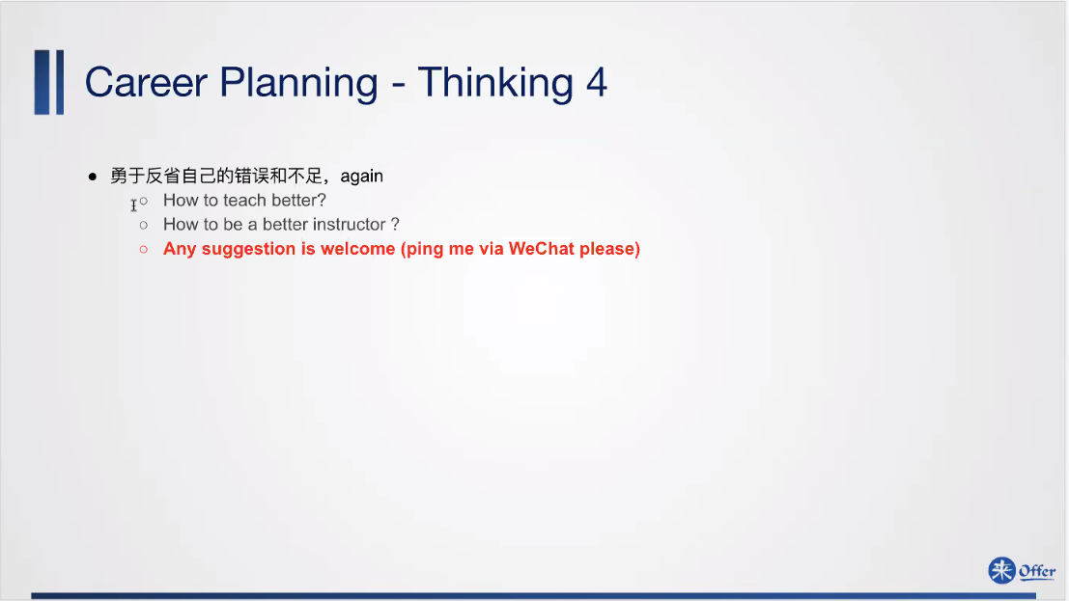

Slide 45
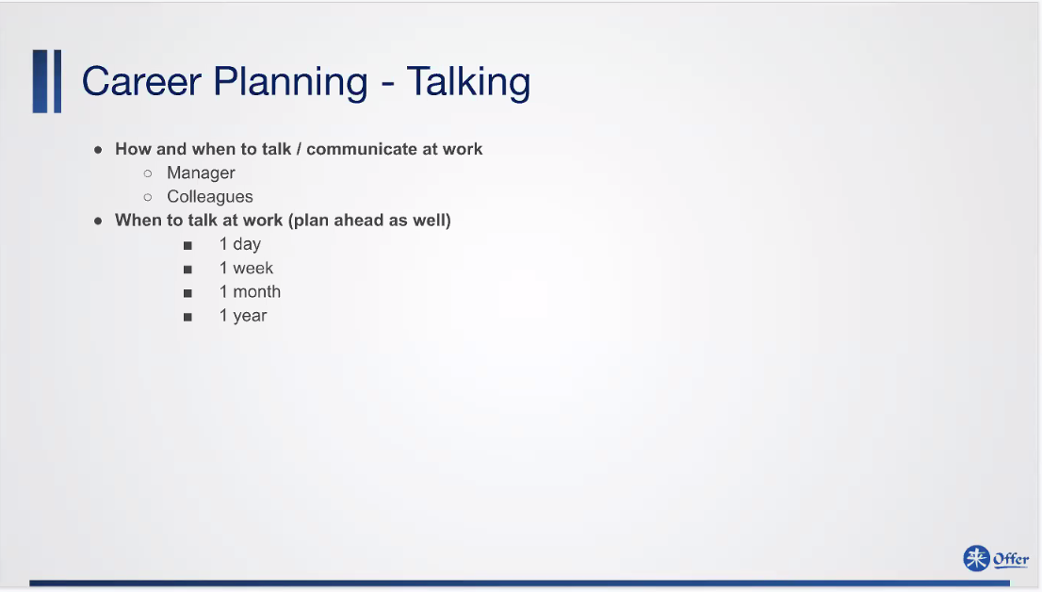
Notes:
Visibility – 1 month per meet, never become nobody
When to plan to talk at work?
First day- introduce yourself with group member
First week – talk with your manager on your plan … - choose a plan, better independent, strongly not prefer x group
First month – group work division, know who is the strongest tech lead; one on one meeting 3 questions (q0 architect understand, group structure, the tree in the forest)
First year – thanksgiving and Christmas, top 3 manager and tech, send them table thank-you card. Broader and Broader road;

Slide 46
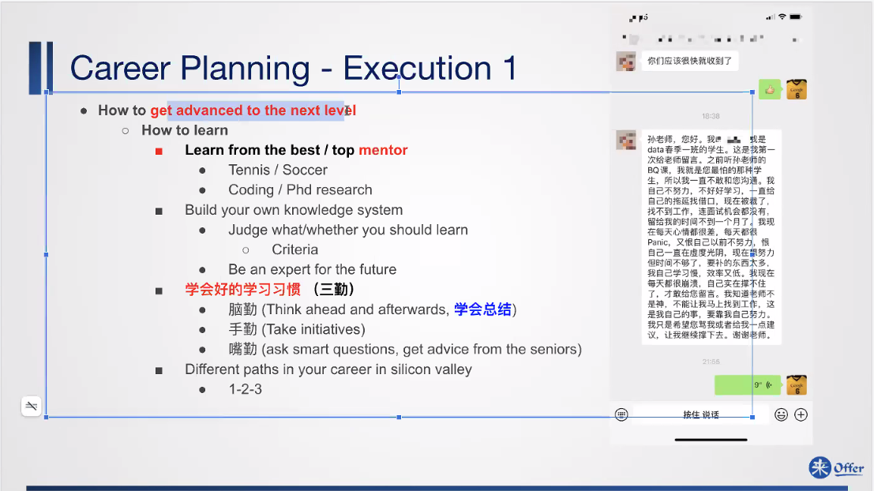
Notes:
How to advance to next level?
Find a mentor – complex system, very suffering, be friend with tech lead;
ask high, middle level question
Become tech lead/experts in one field,
Think about your career before the mid age crisis.

Slide 47
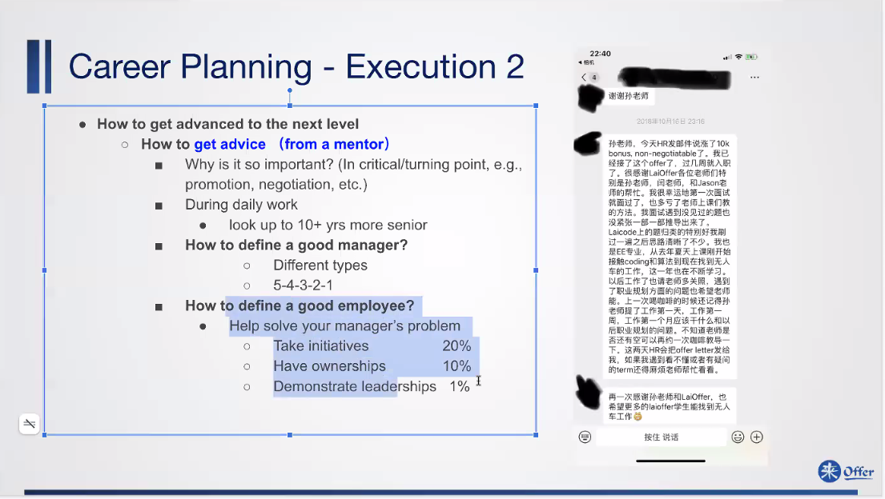

Slide 48
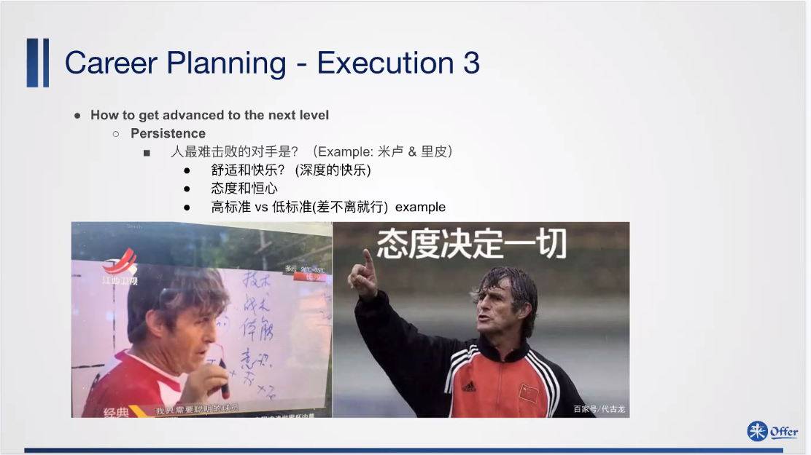

Slide 49
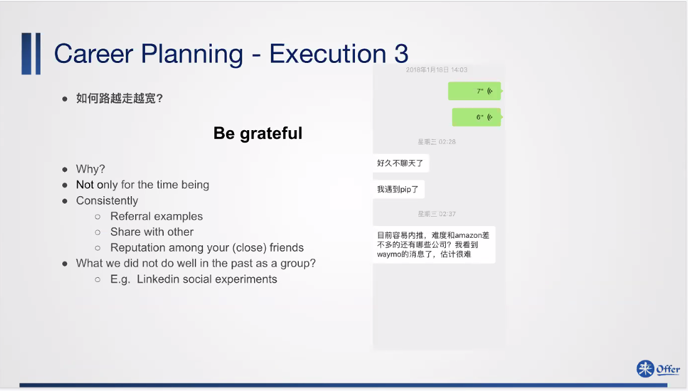

Slide 50
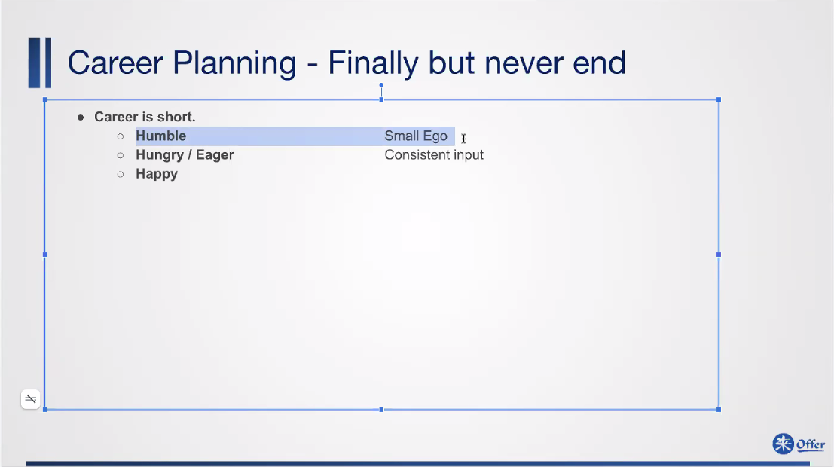

Slide 52
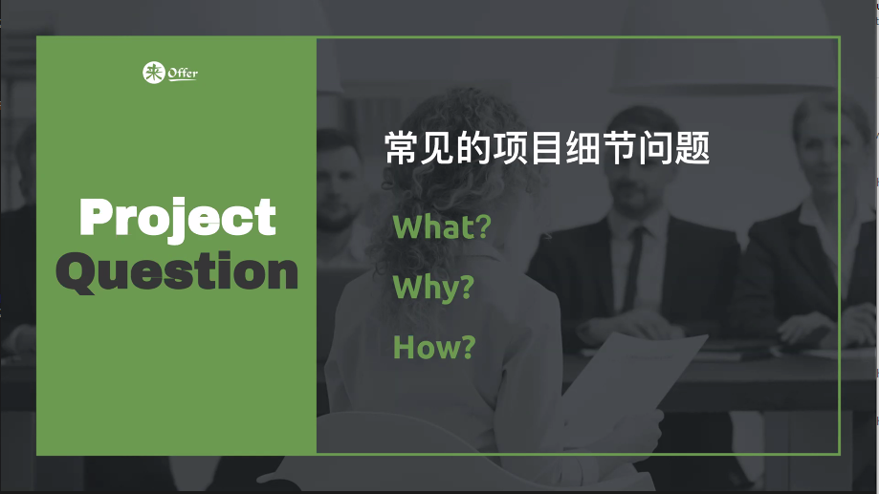

Slide 53


Slide 54

Notes:
Why you add this function?
Normally, data driven; Base on the data analyze, we don’t have tool/product that can make communication with strangers;
Practice technique: test MVC/ make prototype
Make sure from technical part? Or ? -> if missed his intension, then loose interest.
E.g. update not too frequency, the performance increases;
Easy too use. Available for multiple frameworks;
Advantages? So I use this.

Slide 55

Notes:
You have other options / Why do you use this option?
EC2 – autobalancer when increasing the user amount

Slide 56


Slide 57

Notes:
This question is flexible: technical / communication challenging? Soft or hard skill problem?
First time doing REACT? – not good enough – use why and how questions – always complain???

Slide 58

Notes:
Have used product? Technically/In product/ company culture

Slide 59


Slide 60


Slide 61


Slide 63


Slide 64


Slide 65


Slide 66


Slide 67


Slide 68

Notes:
Important services

Slide 69

Notes:
Docker – centralize containerment deployment
AWS lambda – servlet

Slide 70

Notes:
DynamoDB – noSQL
Redshift – volume of data, for non-user use
Deptune – graph relationship

Slide 71

Notes:
Athena
redshift

Slide 72


Slide 73


Slide 74













Slide 75








Notes:
EC2- server
EBS – code/resource
ELB – elastic load balancer
Managed DB: DynamoDB
LAMBA – define dedicated task
Recokonition – recog
Kinesis – topic/usage dumping
Redshift
Router53

Slide 76


